Slide 1
HarNice!
The free, open-source electrical system design tool.

Slide 2
Disclaimer
I wrote this in past tense, but it’s far from done!
This is my first-ever real coding project
I don’t claim that my implementation is any good – just judge my approach!
I’ve never truly used another real systems engineering tool
Maybe I’m reinventing a wheel
Maybe we can steal all their business by making the first free and open source electrical systems engineering tool
DO NOT USE THIS SLIDESHOW FOR HOW-TO ADVICE. INFO AND TERMINOLOGY CHANGED QUCKLY WHILE I WAS DRAFTING THIS PRESENTATION.

Slide 3
What is an electrical system?
Battery
Any collection of circuit boards, devices, other things, that connect to each other with wires or harnesses
Requires engineering trades and decisions to design
Examples:
Concert sound system
Avionics system on a rocket or satellite
Commercial power distribution system
iPhone
Vehicle computer
Power distribution unit
Network switch
Actuator controller
Sensor DAC unit
Actuator
Pressure sensor
Pressure sensor
Pressure sensor

Slide 4
What is not an electrical system? (from the perspective of HarNice)
Specifics of the electrical behavior going on inside a device
We take the assumption that any device has inputs and outputs and what it does to relate the two is not part of “system engineering”
It’s okay to simplify what a box does as long as it does not jeopardize your understanding of its external functionality
Network routing
Software configs are agnostic to the electrical systems
How your electrical hardware interacts with non-electrical things
We don’t care about g-loading, what kind of fluid your sensors are measuring, etc

Slide 5
How do you design your system right now?
The competition:
Zuken, E-plan, etc
SUPER expensive, cumbersome, training-intensive
Pen and paper vibes: hardly better than graph paper
Alternatively, Vizio, Powerpoint, Excel, MS Paint
No metadata in your drawings
No enforceable design rule checks
Conflicting sources of truth
Required manual dependencies
No centralized revision control

Slide 6
Harnice solves this.
There can and should always exist one single source of truth for any entire electrical system.
On the assumption that the following are known, every artifact (harness drawing, BOM, etc) should be fully deterministic.
Your system is fully defined
You know how many devices you need and how you want them to be connected
You have complete details about how each device works
Device connectors and channels are fully defined
Every design standard you adhere to is expressible
Ex. “We always put yellow heat shrink if the harness contains a signal with this name”
Ex. “Every time a harness contains more than two receptacle connectors, switch the font size on the label”
The physical routing of a harness can be imported or asserted
Harnice doesn’t know how long a harness needs to be

Slide 7
How do you know what to design?
Traditionally, the engineer compiles information either from a design guide, from industry knowledge, or other sources,
…manually…
until their design is complete.
INSTEAD:
Harnice encourages the user NOT to compile any information, and instead, explicitly document your design standards and rules in a machine-readable format.
Let the machines work for you!

Slide 8
High-level requirements
Harnice shall have just one command which should update everything about a product
Harnice shall allow users to input their design rules using a well-known human-readable language
Harnice may only produce ONE deterministic solution to any product, and raise an error if multiple or zero solutions are found
Harnice shall not operate on released parts`

Slide 9
Flexibility requirements
If you can define something as an “instance” with “attributes”, it should be able to end up in a harness build file.
Harnice shall minimize the number of terms that represent physical goods. The terms “connector” or “cable” don’t inherently mean anything

Slide 10
The solution
Kicad
You specify your system using Kicad or Altium
Components represent devices
Nets represent harnesses
Harnice runs a bunch of code on your netlist to determine harness requirements
Builds a channel map
Builds a System Instances List (list of every part and every connection for every harness)
Harnice harness editor can look for a harness inside a system
Adds parts based on standard build rules
Exports build drawings and other artifacts instantaneously
Device definitions
Netlist
Channel definitions
Channel map
System Feature Tree
System instances list
Harness Feature Tree
Harness instances list
Harness drawings

Slide 11
a word on terminology…

Slide 12
Term | Description | Scope | Attributes | Examples
“System” | A complete overview of every relevant piece of hardware in your system | Systems contain devices and nets | Which device part numbers and how many are you using How each device is connected to each other | Vehicle HITL Test stand Concert sound system Residential AC power distribution
“Device” | A physical device that interfaces with other devices via hardware electrical signals |  | Part number Connectors Channels | Pressure sensor ADC Light switch MacBook
“Channel” | A set of signals | Devices have Channels Channels exist in a centralized library Channels are not allowed across multiple connectors yet | Other compatible channels Input, output, or both Range, tolerance Data format | “Power in” “Mic level signal” FTT (4-20mA) 500mHz 50ohm
“Signal” | An individual conductor going in or out of a device | Channels are defined to contain Signals Device Connectors must contain all device Channels’ Signals | Signal name | +5V Chassis CS, MISO, MOSI
“Net” | A set of connectors | Nets defined at the system-level Nets are not harness part numbers | Which connectors of which devices are included in the net | N$1
“Harness” | A physical device that exists to link devices together | Harnesses contain Circuits and mating connectors | Harness part number Contained parts | Lightning cable Your favorite octopus harness
“Circuit” | A connection between one signal and another | Circuits contain contacts, conductors, etc that form an electrical path | Name | Channel 1 +5V

Slide 13
The Harnice workflow
User editable per product
Generated file
When you “render” a product (run harnice –r <product> from the command line), the feature tree is called
Feature Tree pulls from existing information, processes it, and makes artifacts
harnice –r device
Device Feature Tree
Device Signals List
Device Kicad Symbol
System Definition (kicad_sch)
System Feature Tree
System Instances List
harnice –r system
Harness feature tree
Harness Instances List
Harness Build Drawing PDF set
harnice –r harness

Slide 14
Harnice products
When you “render” a product, inputs are converted to outputs
 | System | Harness | Device | Part | Title block | Flagnote
Inputs (existing information) | Netlist exported from Kicad or Altium | System instances list, manual YAML or JSON harness definition | ICD.py |  | Params.json | Params.json
Generated outputs | Instances list.tsv | Instances list.tsv | Signals list.tsv .Kicad_sym | Attributes.json Drawing.svg | Attributes.json Drawing.svg | Drawing.svg

Slide 15
Harnice workflow – for systems
User editable per product
Harnice module
Import from library
harnice --render system
Generated file
Netlist from Kicad
Part number feature_tree.py
Kicad to bom macro
System bom
Import parts from library
Make connector list
Connectors list
Make channel map
Your channel map preferences
Channel map
Make disconnect map
Your disconnect map preferences
Disconnect map
Make circuits list
Weird rules you might need
Circuits list
Make instances list
Weird macros you might want
System Instances list

Slide 16
Feature Tree
Example of inputs
User editable per product
Harnice module
System instances list if relevant
Import from library
Generated file
harnice --render <product>
Input file(s) if relevant
Regardless of which product you’re working on, when you call “render”, harnice will run “featuretree.py”
Feature Tree, notionally based on Solidworks, will sequentially build up the product’s data structure
Feature Tree will also call macros, which do stuff like generate a BOM, make a PDF drawing, etc
Part number feature_tree.py
Part(s) if relevant
Build macro
Build macro
Build macro
Product data structure
Flagnotes, tblocks if relevant
Example of outputs
Output macro
Output macro
Output file
Output macro
Output file
Output file

Slide 17
Harnice workflow – for harnesses
User editable per product
Harnice module
Import from library
Generated file
System instances list
harnice --render system
Part number feature_tree.py
Your weird build rules for this project
Build macro
Your company’s build rules
Harness instances list
Build macro
Harness instances list
Build macro
Harness instances list
Output macro
PDF drawing
Output macro
BOM
Output macro
Vdrop calcs idk

Slide 18
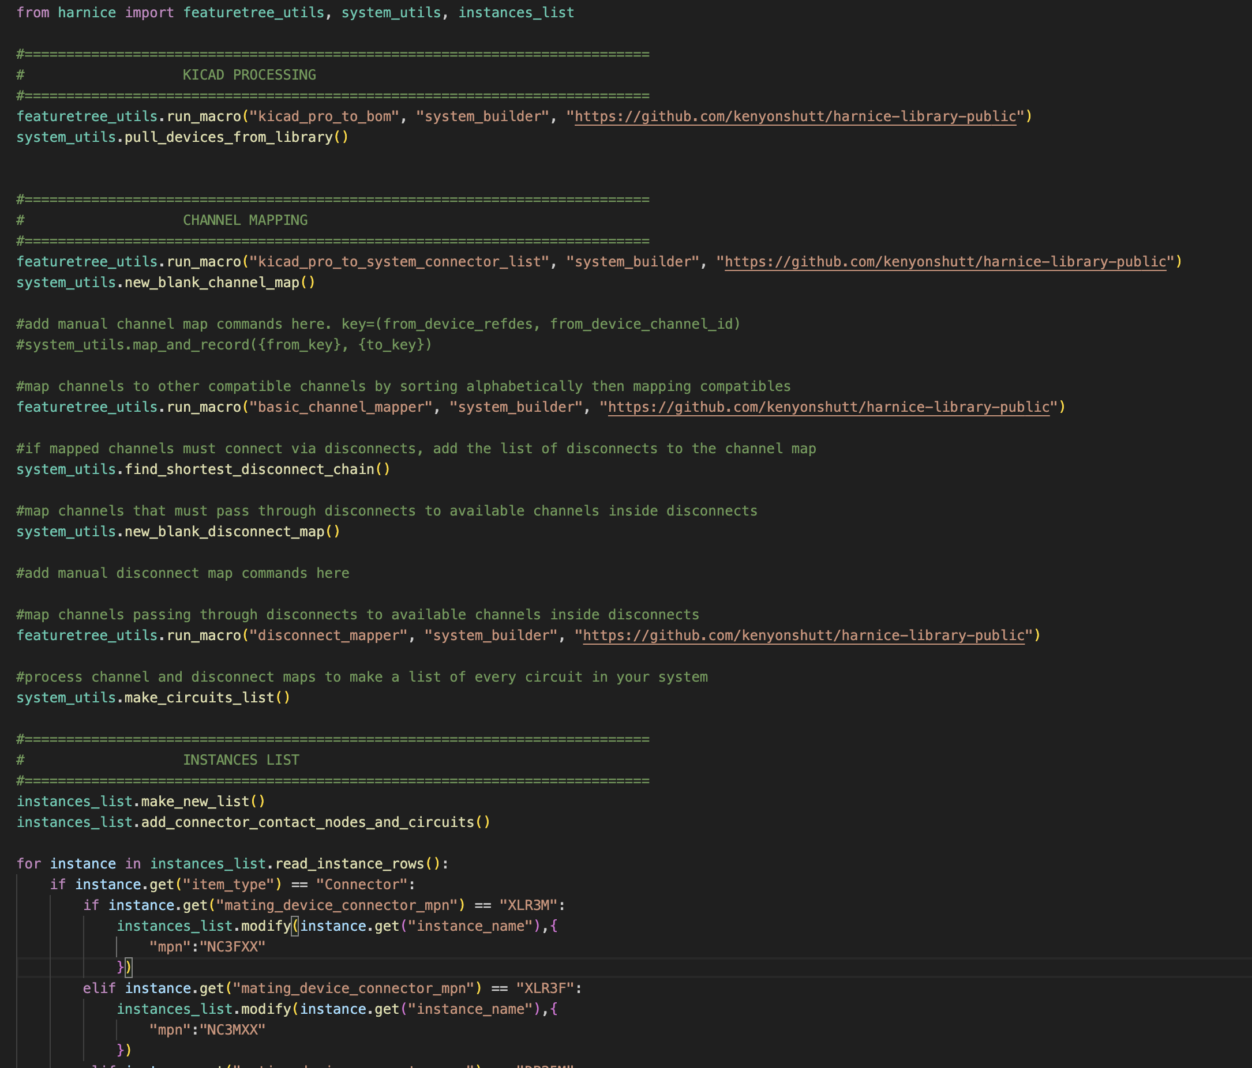
System Feature Tree Example

Slide 19
Channel Types
Refer to a channel type as
channel_type = (channel_type_id, repo)
Represents a type of channel that is compatible with other channels of similar types that can be mapped to each other.

Slide 20
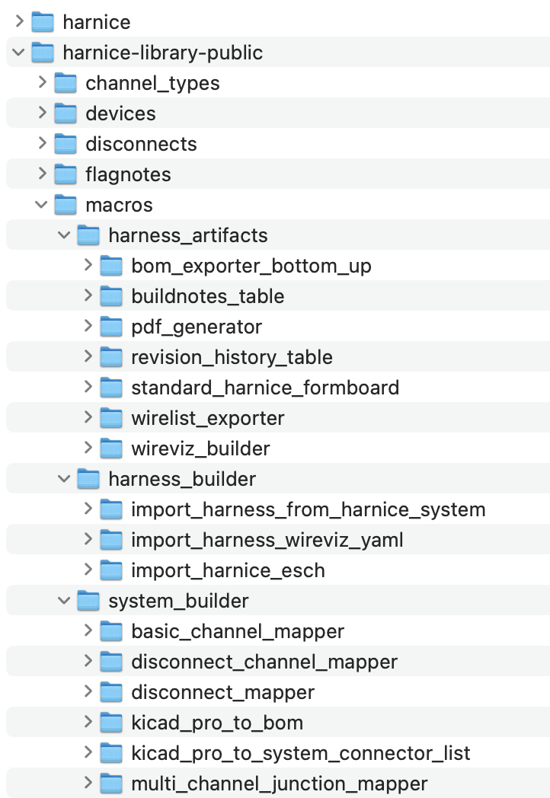
Macros
Macros I currently have written in the public library
A macro is a chunk of Python that has access to your project files or any other Python-capable function
When you call featuretree_utils.run_macro(), it will import the macro from a library and run it in your script
Some macros are designed to be used to build systems, build harnesses, or export contents “artifacts” from a harness instances list

Slide 21
Build Macros
Intended to add or modify lines on an instances list based on a standard set of rules or instructions
Can read information from the instances list
Can read information from other support files
Examples
featuretree.runmacro(“import_wireviz_yaml”, “public”)
Reads a wireviz YAML (another commonly used harness design format)
featuretree. runmacro(“add_yellow_htshrk_to_plugs”, “kenyonshutt”)
You can write any rule or set of rules you want in Python, save it to your library, and call it from a harness feature tree.
This one, for example, might scour the instances list:
for plug in instances_list:
if item_type==plug:
instances_list.add(heatshrink, to cable near plug)

Slide 22
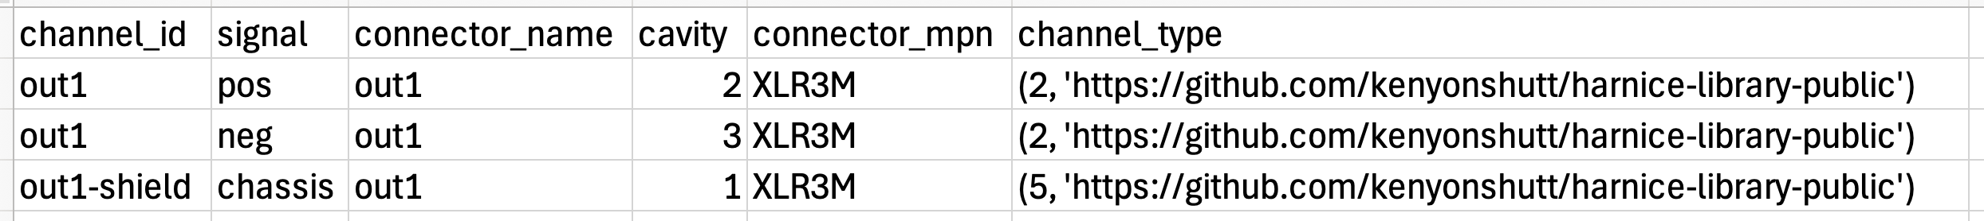
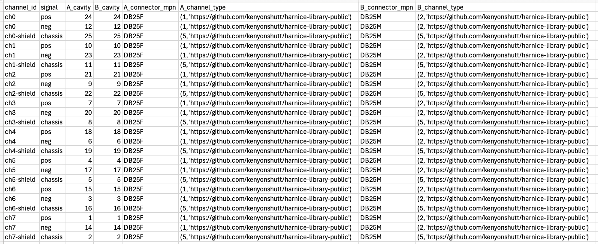
Signals Lists
Device signals list (for Shure SM58 microphone)
Signals Lists are the primary way Harnice stores information about devices
Source of truth for devices or disconnects
Exhaustive list of every electrical connection going into or out of the device or disconnect
Disconnect signals list (for a bespoke audio use case)

Slide 23
Rules about Signals Lists
Every combination of (channel_id, signal) must be unique within the signals list
You can’t have two “ch1, pos” signals on the same device
Every signal of a channel_type must be present in the Signals List
If your channel_type requires “positive” and “negative”, you have to have both in your signals list
Every signal in the Signals List must be present in the channel_type
If you need to add signals that aren’t already part of your pre-defined channel_type, you’ll need to define a new channel_type.
You can’t put signals of the same channel on different connectors
While this may sound convenient, it breaks a lot of internal assumptions Harnice is making on the back end about how to map channels.
If you need to do this, I recommend defining one channel type per signal, then write a macro for mapping the channels to their respective destinations.
“A” and “B” channels of the same disconnect must be compatible with each other

Slide 24
Signals List Fields
signals_list.write_signal()
Device signals list
channel_id | signal | connector_name | cavity | connector_mpn | channel_type
Unique name of the channel that this signal is part of | Electrical signal “positive”, “TX”, etc | Name of the connector | Cavity name of where this signal lands on your device | Be specific, this may directly end up in your BOM later | Intended purpose, mate, and map compatibility is contained here
Disconnect signals list
channel_id | signal | A_cavity | B_cavity | A_connector_mpn | A_channel_type | B_connector_mpn | B_channel_type
Unique name of the channel that this signal is part of | Electrical signal “positive”, “TX”, etc | Cavity name of where this signal lands on the “A” side of this disconnector | Usually the same as “A” cavity if the connectors are compatible | Be specific, this may directly end up in your BOM later | Intended purpose, mate, and map compatibility is contained here |  | Not necessarily the same as “A_channel_type” because one side of disconnect is usually “input” and the other is “output”

Slide 25
Signals List Feature Tree
You can use a script to easily write long Signals Lists. Rely on basic Python to avoid typing manually.
harnice -r device
Or
harnice -r disconnect
Signals List Exists
no
yes
Feature Tree Exists
Feature Tree Exists
yes
yes
no
no
Make new feature_tree.py from default
Run feature_tree.py
Validate and exit

Slide 26
KiCad Integration
When you render a device Signals List, it’ll make a KiCad schematic symbol in the parent directory
KiCad Symbol will contain ports that match the set of connectors that you’ve specified in Signals List
Render will not affect placement or graphic design of your symbol, just port count and symbol attributes

Slide 27
Signals List Lightweight Render
If you need to build a KiCad block diagram quickly, without specifying channels and signals, you can with --lightweight.
Run harnice -l device or harnice --lightweight device from your device directory.
This will follow the same flowchart as --render, but truncate the validation process.
You will not be able to map channels with --lightweight

Slide 28
Signals List Python Commands
Command | Args | Returns | Purpose
signals_list.new_list() |  |  | Create a new list
signals_list.write_signal() | See earlier slides on what’s required and why |  | Add a signal to a signals list
signals_list.signals_of_channel() | Channel type in touple form (channel_type_id, repo) | List of all the signals of that channel type | Use to validate that you’ve specified all the necessary channels when constructing a signals list
signals_list.compatible_channel_types() | Channel type in touple form (channel_type_id, repo) | List of touples of all other compatible channel types | See if a channel in question is compatible with another channel
signals_list.cavity_of_signal() | channel_id (what channel are you looking for) signal (what signal are you looking for) path_to_signals_list (where are you looking for it at) | Cavity | Quickly find which cavity a signal of a channel lands on in a specific device
signals_list.connector_name_of_channel() | channel_id (what channel are you looking for) path_to_signals_list (where are you looking for it at) | Connector name | Quickly find which connector a channel exists on in a specific device
signals_list.path_of_channel_type() | Channel type in touple form (channel_type_id, repo) | Local path to a channel_types spreadsheet | Given a channel_type touple, find the local path to its source-of-truth channel types list
signals_list.parse_channel_type() | Channel type in touple form (channel_type_id, repo) | list of size 2: [int channel type id, | Given a channel_type touple, split it into parsed values that are easy to interact with

Slide 29
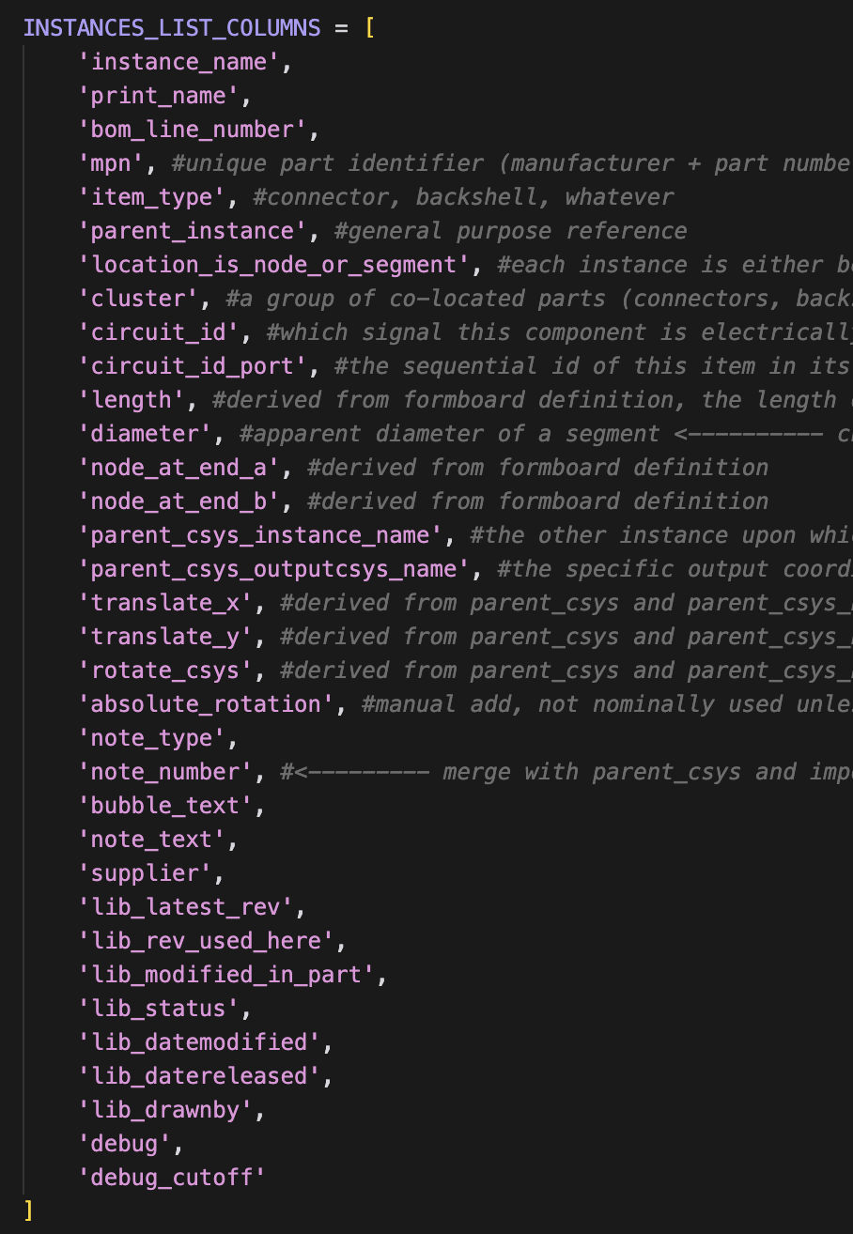
Data structure: “instances_list.tsv”
A list of every single item, idea, note, part, instruction, circuit, literally anything that comprehensively describes how to build that harness or system
TSV (tab-separated-values, big spreadsheet)
Declined alternatives: STEP files, schematics, dictionaries not general, descriptive, or human readable enough

Slide 30
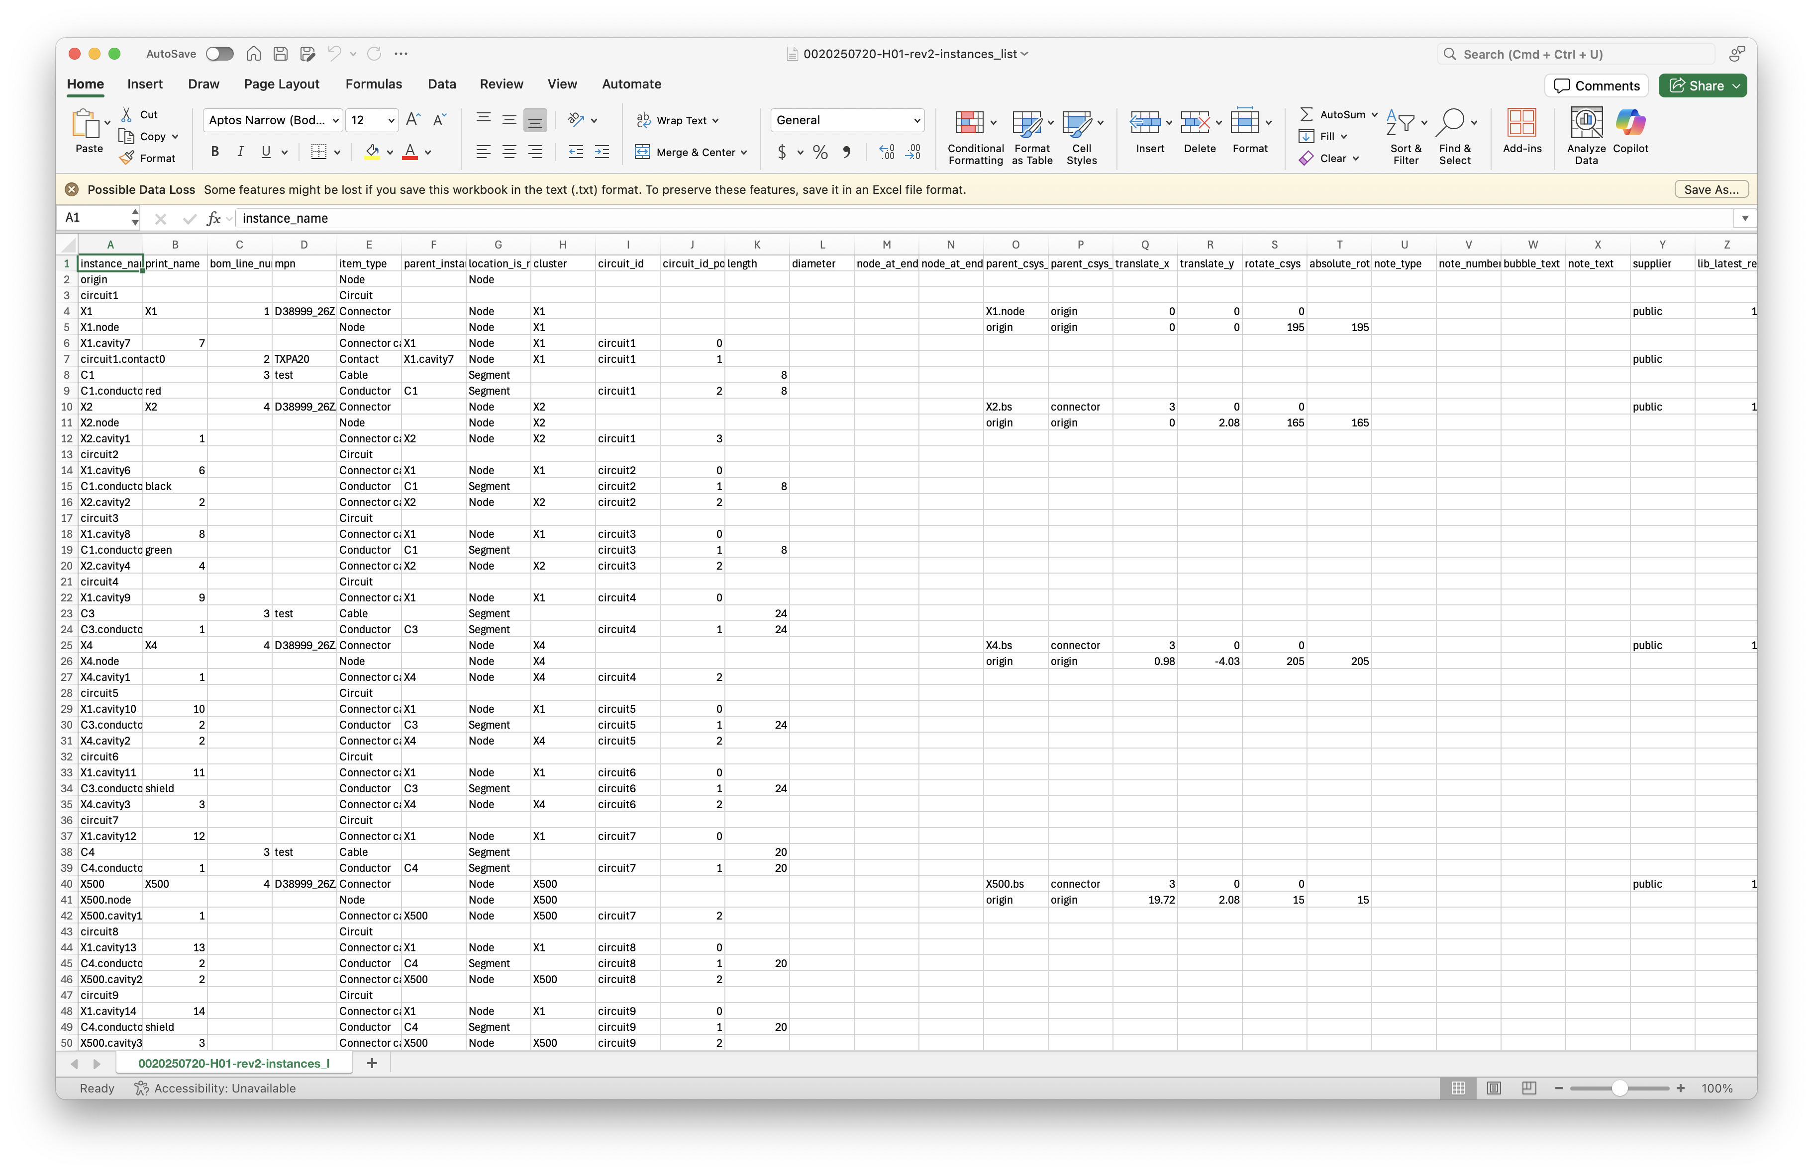
Harness Instances List example

Slide 31
Local Paths vs Traceable URLs

Slide 32
Libraries
Parts, macros, titleblocks, flagnotes, etc, should be re-used and referenced for any future use
Users are heavily encouraged to contribute to the public git repo for your cots parts
harnice-library-public
However, you can define paths to as many library repos as you want.
my-company-harnice-library
my-super-top-secret-harnice-library
You don’t even have to use git to control it if you don’t want!

Slide 33
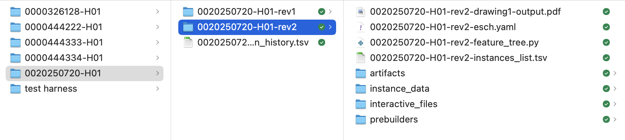

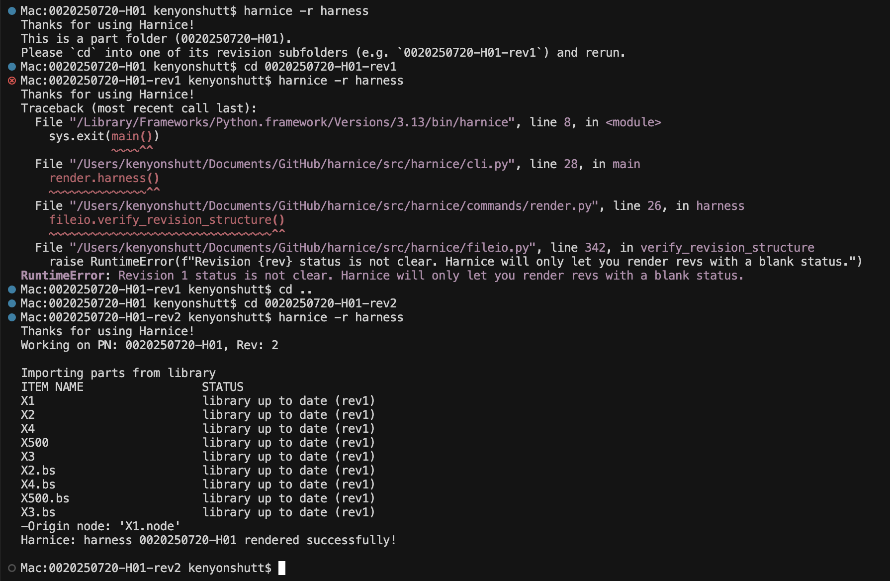
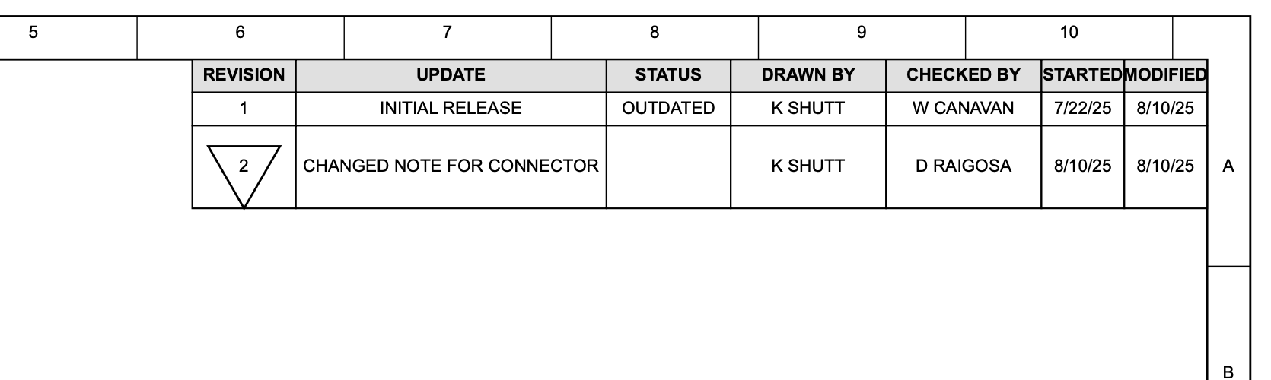
Product version control
To “render” a product (harness, part, etc) with Harnice, the CLI will force you to operate in a “rev folder”
Revision data always stored in revision_history.tsv
Harnice will not render a revision if there’s data in the “status” field, i.e. “released” or “outdated”
Revision information can be referenced elsewhere, ex in pdf_generator

Slide 34
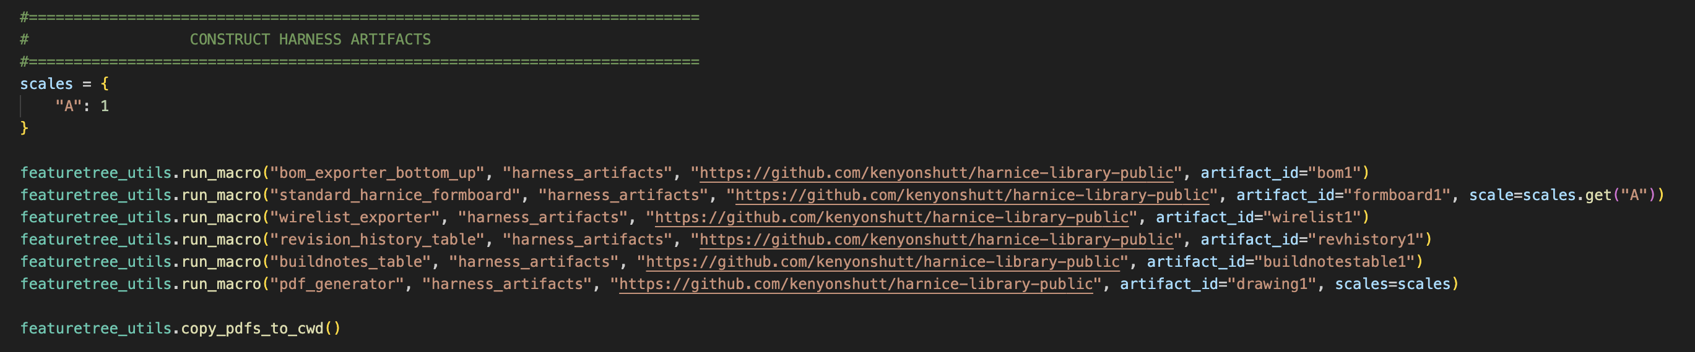
How to Make Outputs!
Output Macros will scour the Instances List or other artifact outputs and make other things out of it
BOM
Formboard arrangement
PDF drawing sheet
Analysis calcs
Write your own!

Slide 35
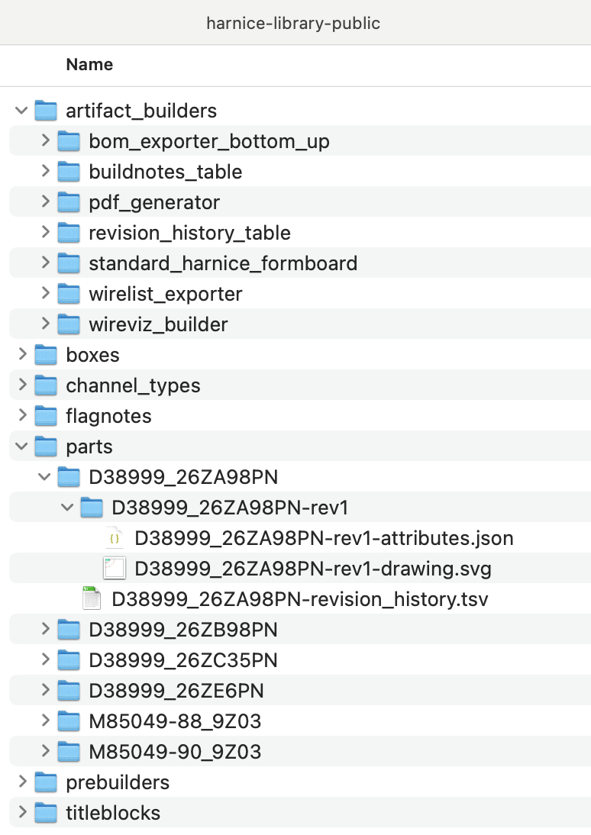
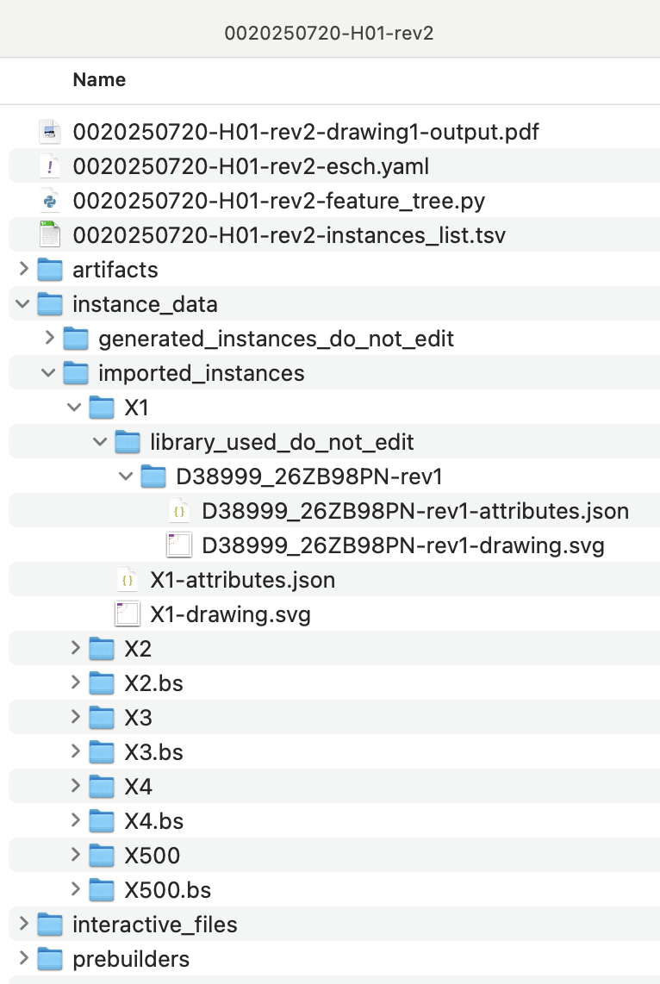
Library flexibility
All parts in a library are version controlled per previous slide…
When importing an item from library, you can request different versions or overwrite imported libraries flexibly…
Library will be imported new at every Render for traceability purposes
User-editable copy (instances_list tracks “modified” from imported library)
revision_history.tsv to track all revisions of a product
Different instances, even with the same MPN, are imported separately
All imported items work the same way

Slide 36
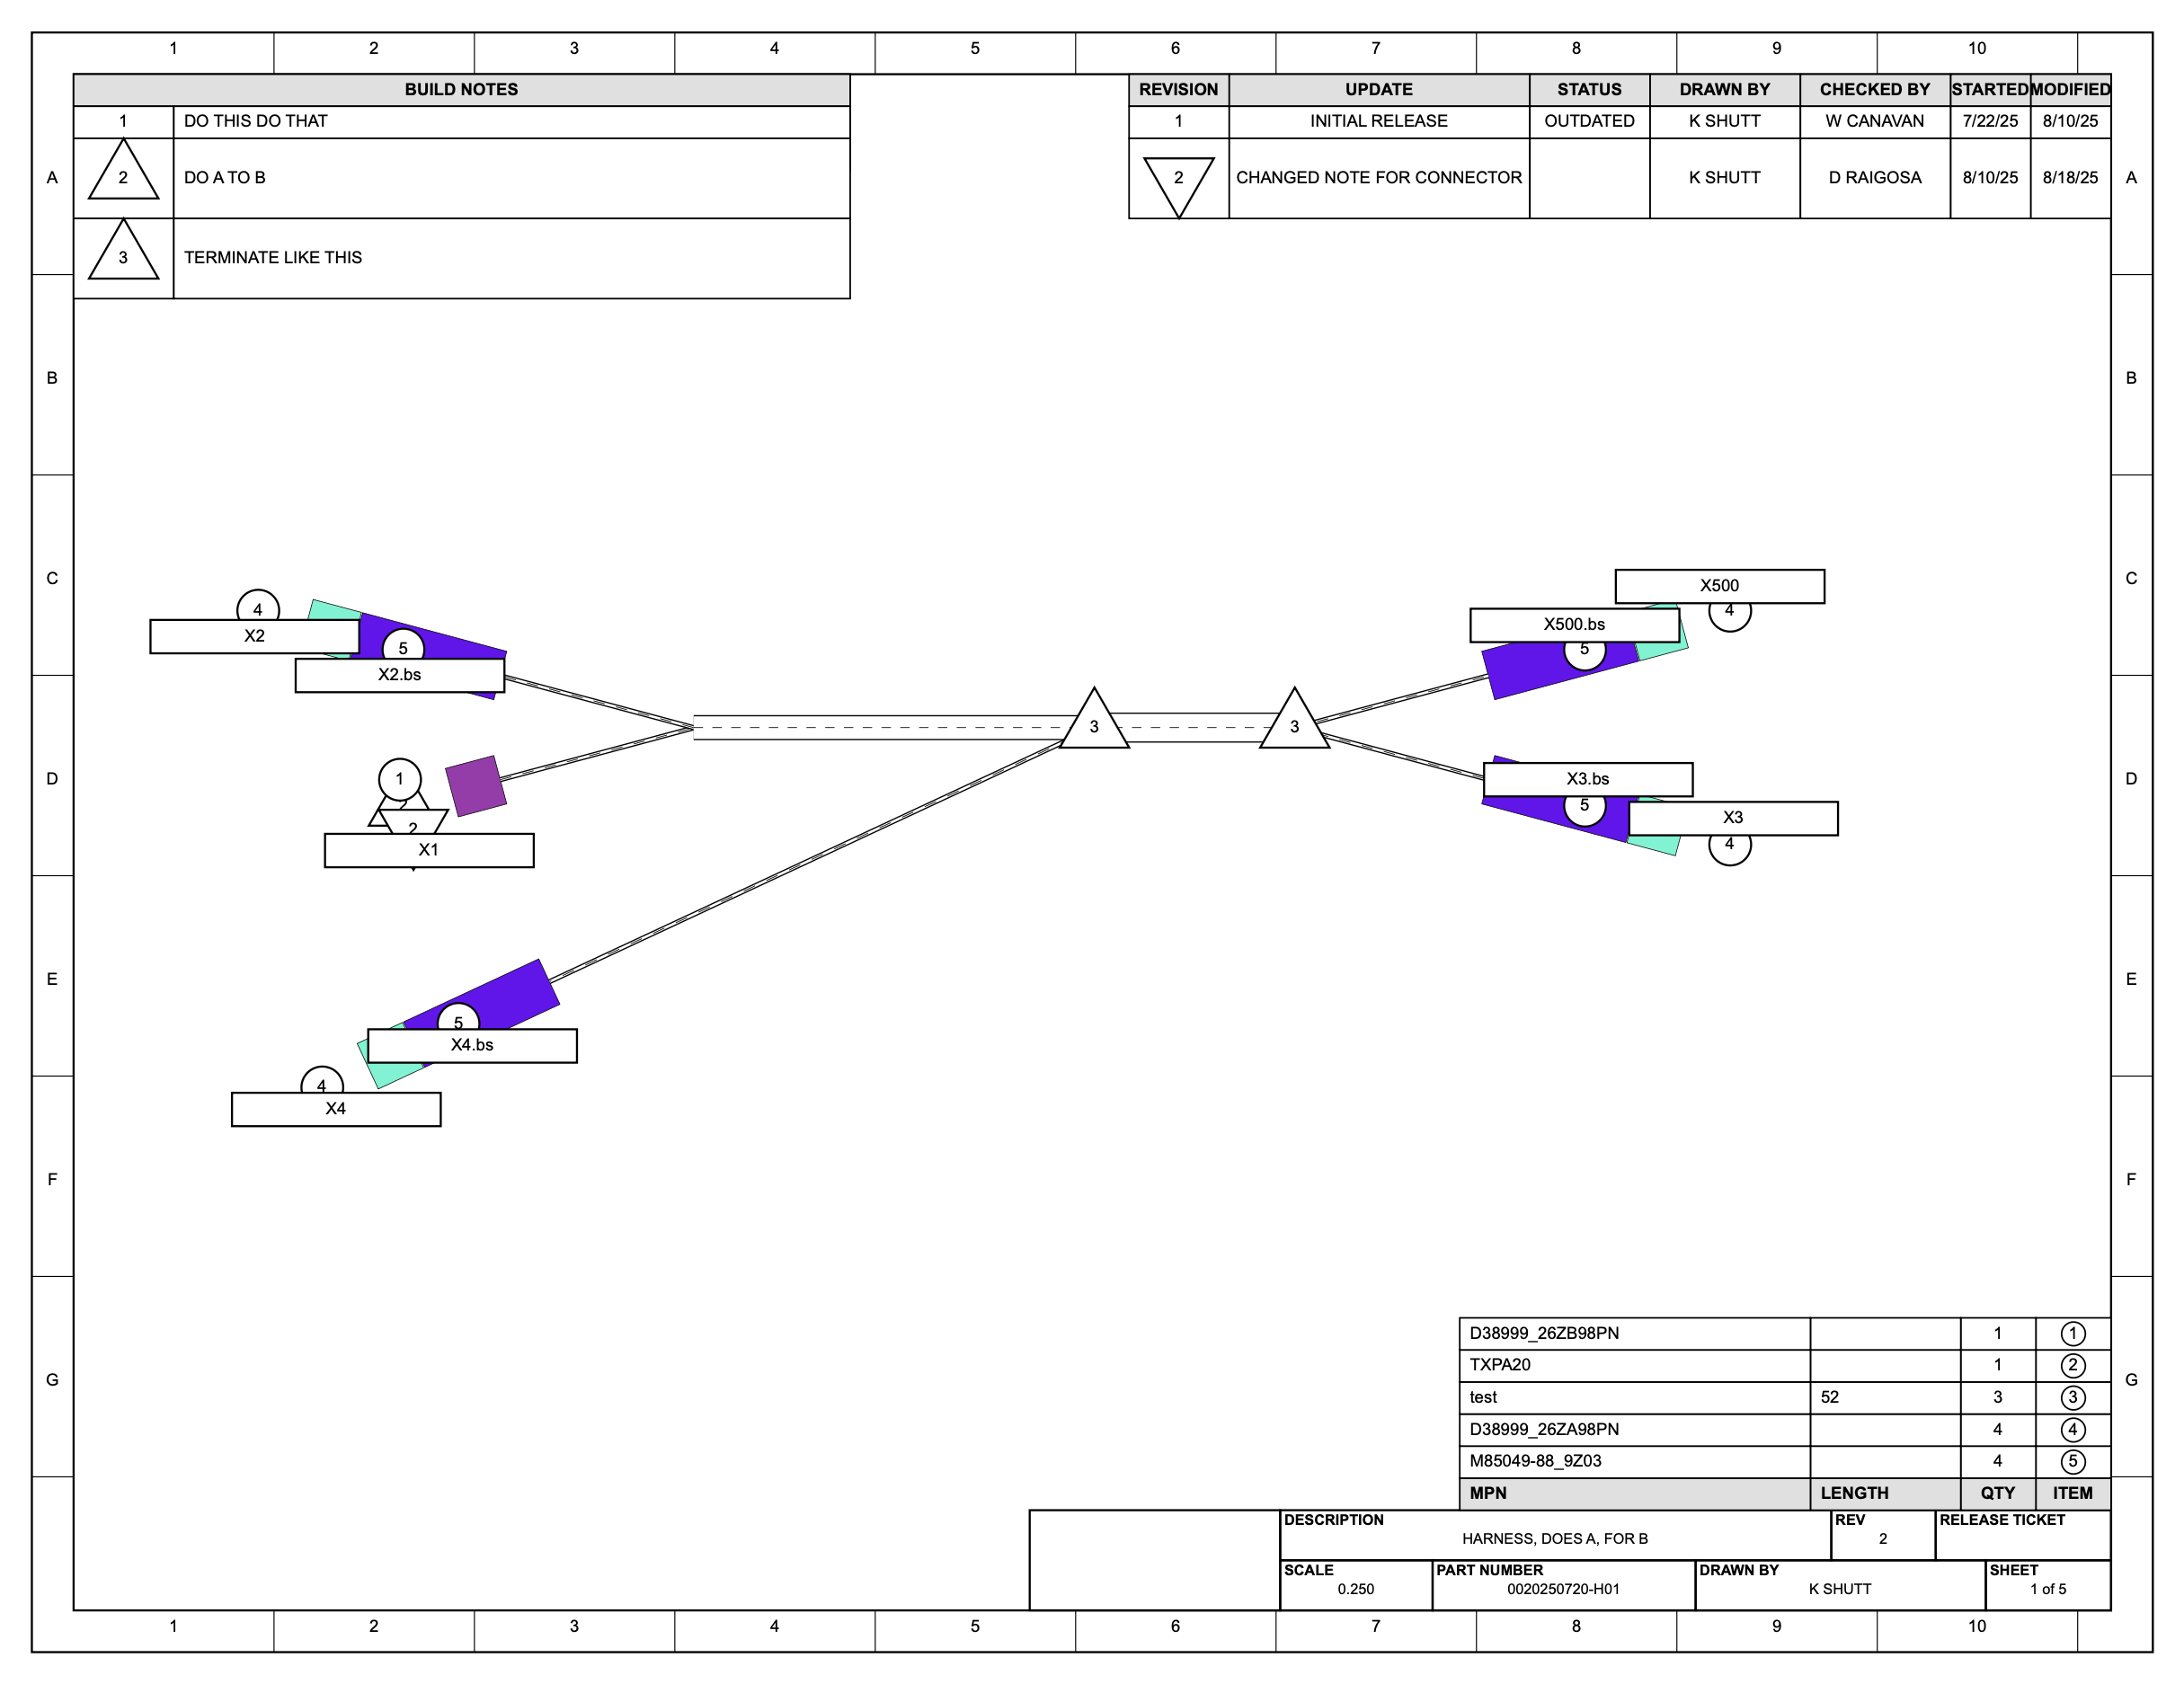
Show me what you can do!
Here’s an output from a macro called “pdf_generator”.
It compiled the outputs of other output macros like “harnice standard formboard builder”, “bom to svg”, “buildnotes to svg”
It knows the scale, the location, the buildnotes you need, what your parts look like, the revision history, all from the information on the Instances List

Slide 37
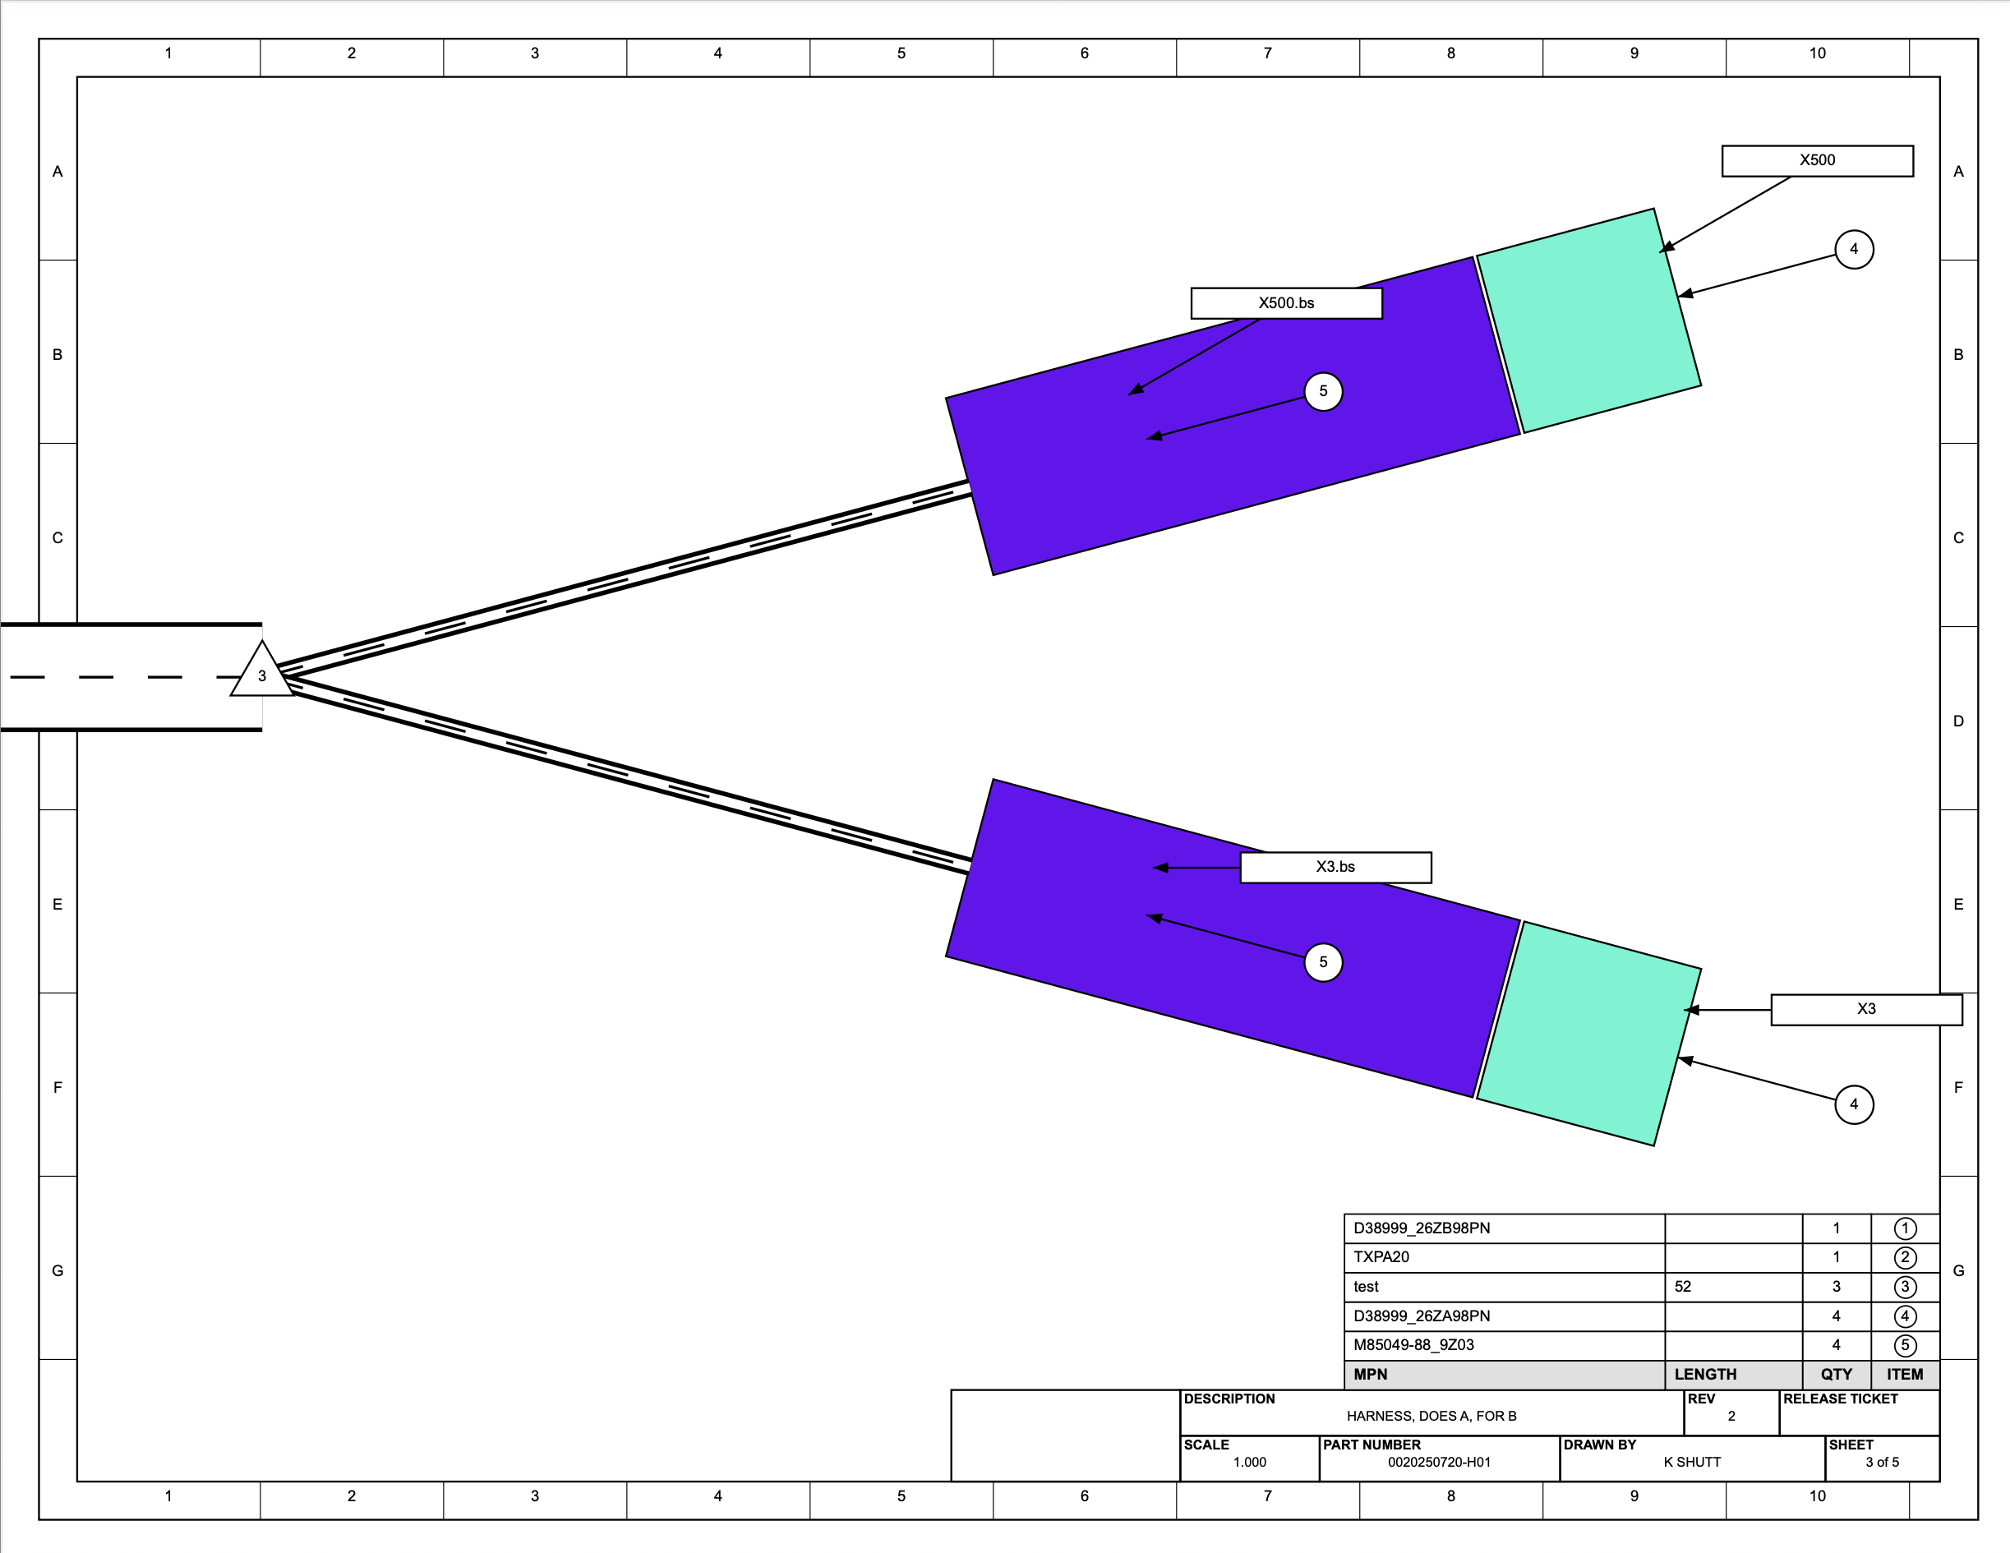
Another page shows a 1:1 scale view on a 8.5”x11” sheet.
Connectors and backshells shown here are just rectangles, but could easily be photos or CAD screenshots.
Flagnote positions are not well-defined, but can be configured as needed.

Slide 38
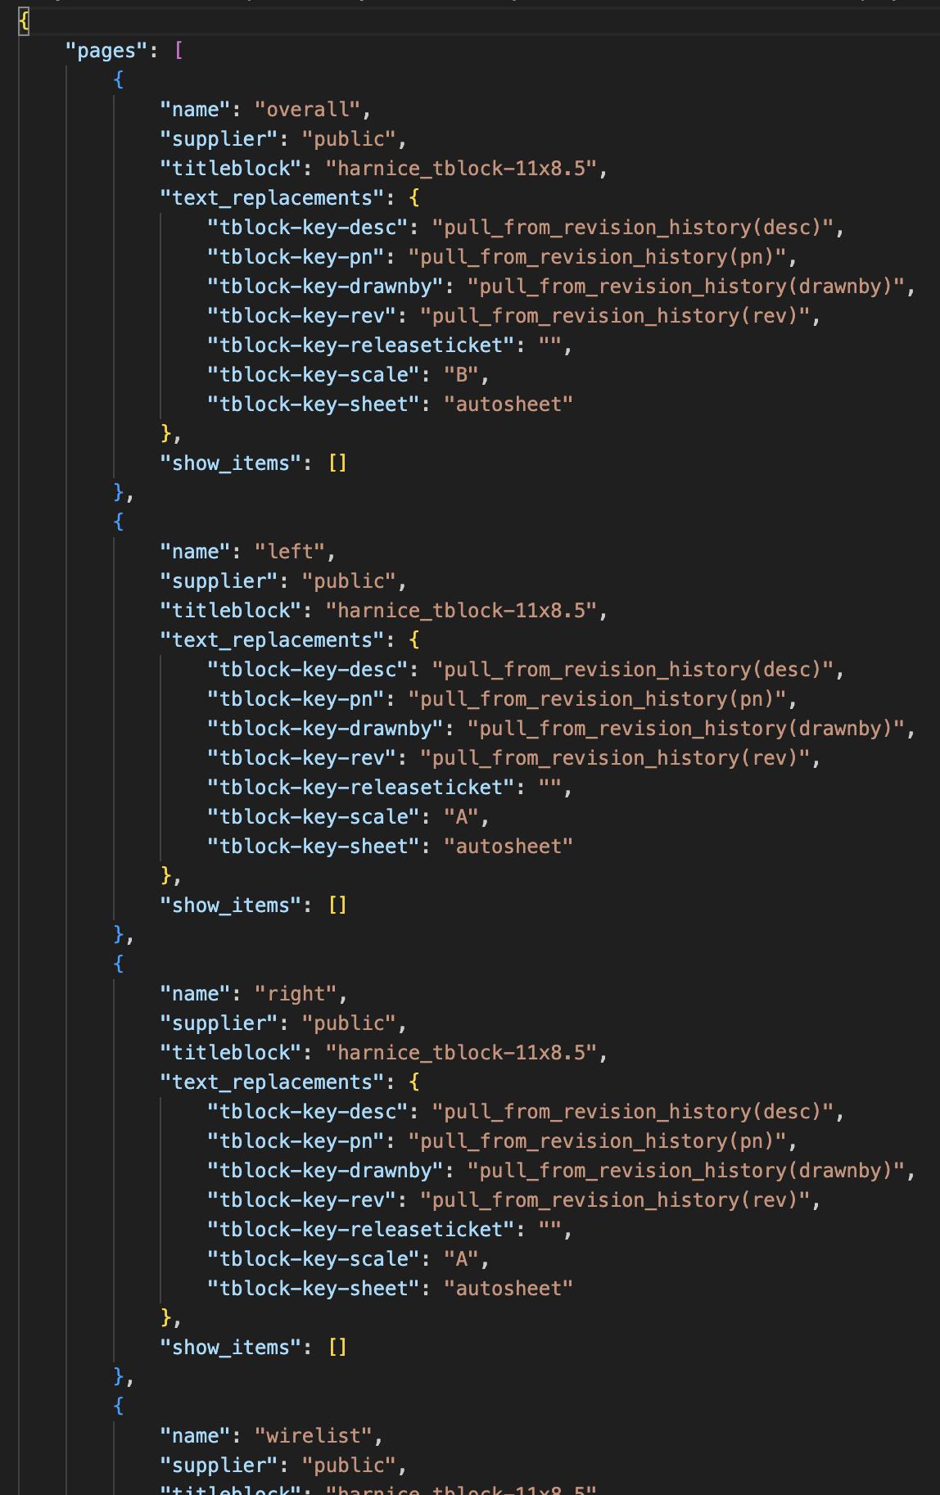
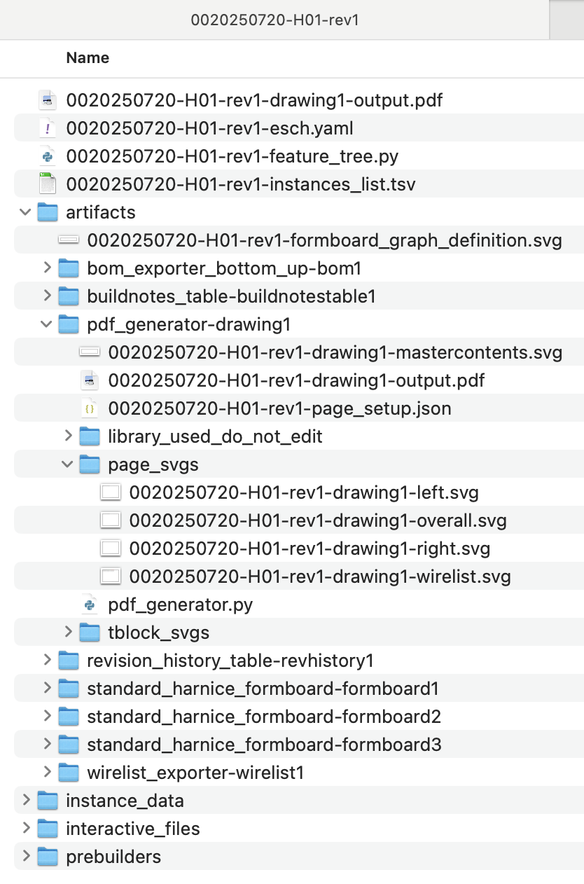
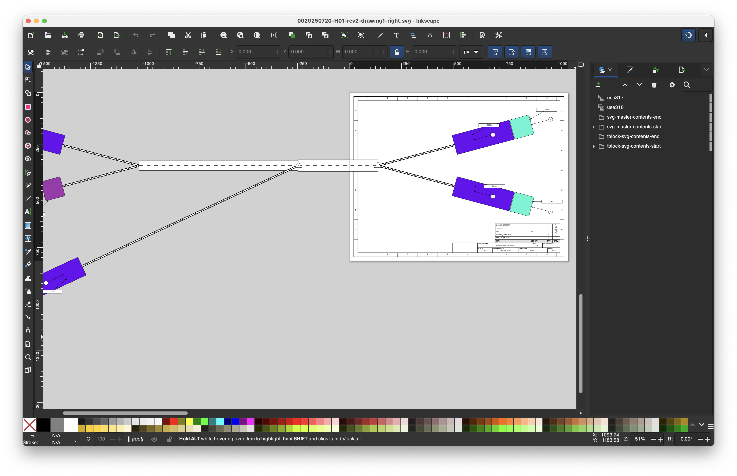
Pages can be edited with your favorite SVG editor…

Slide 39
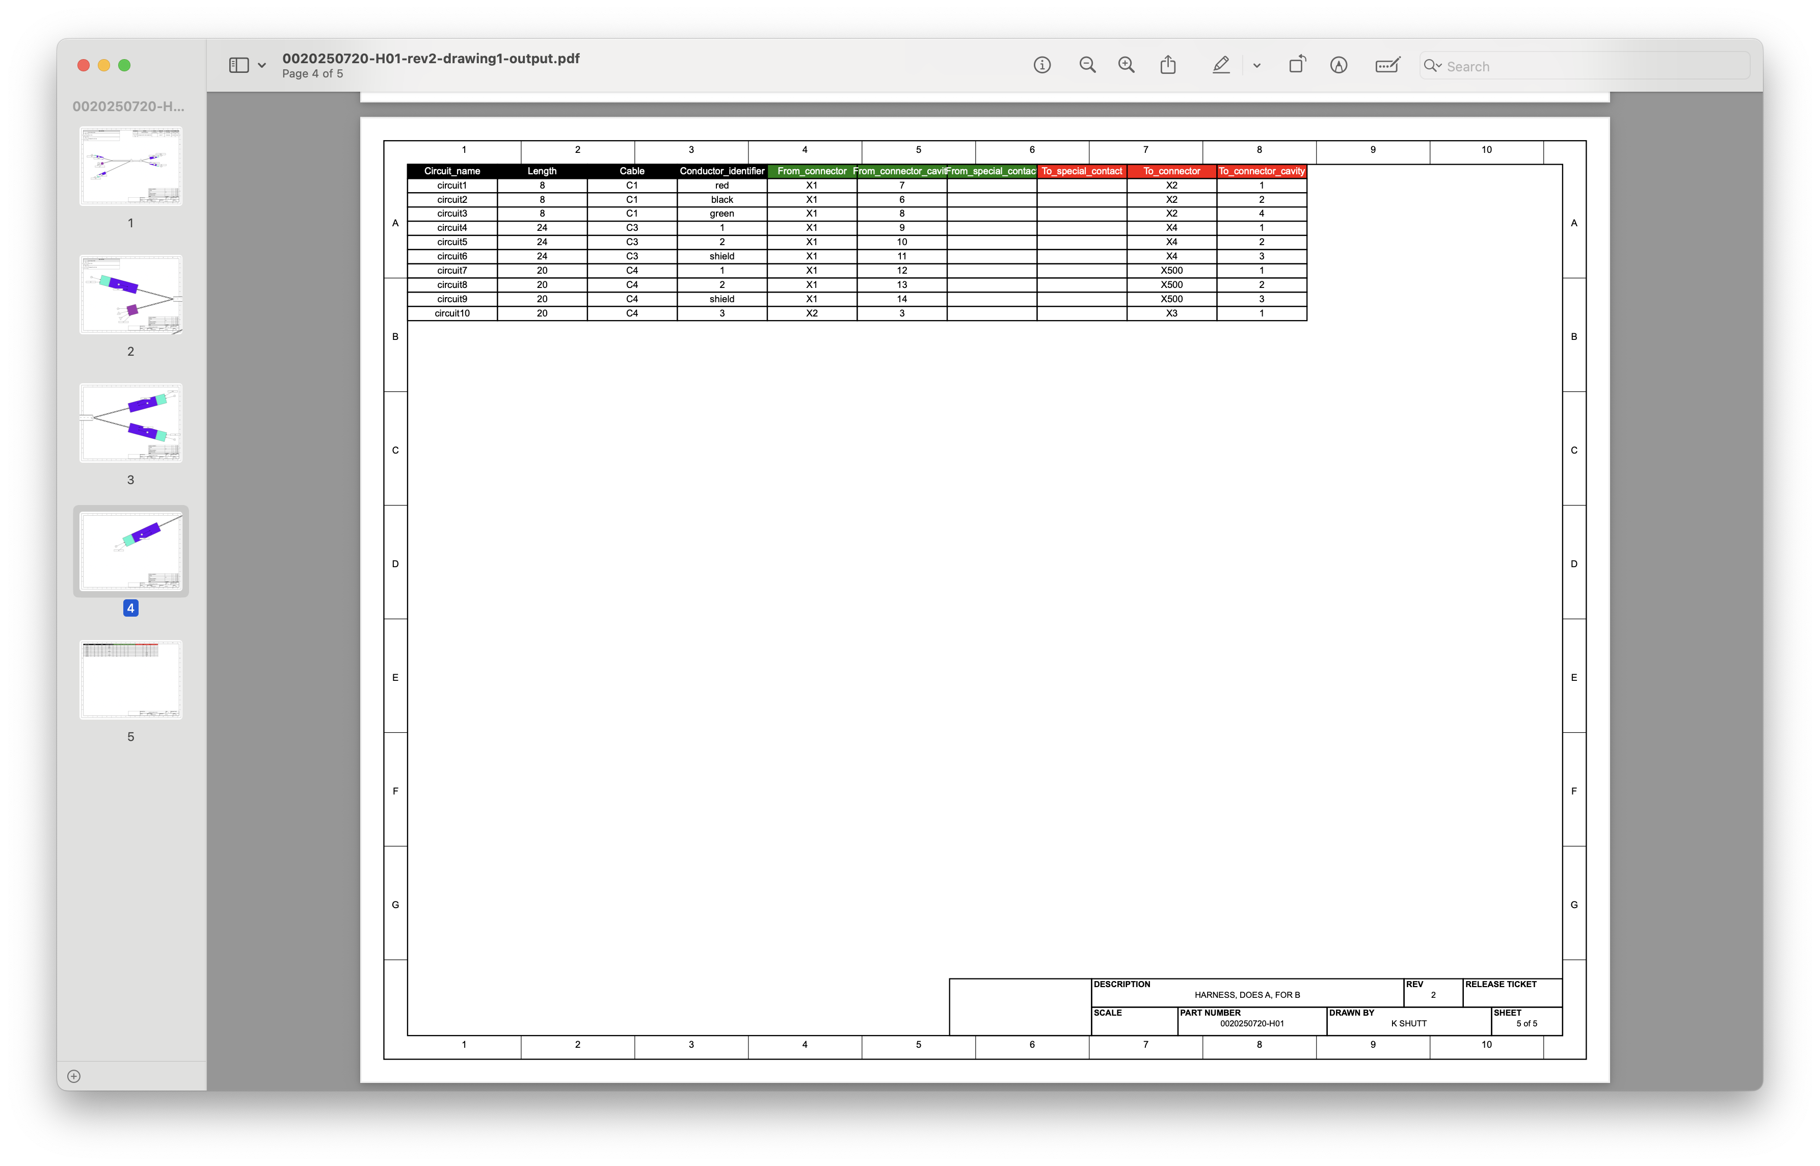
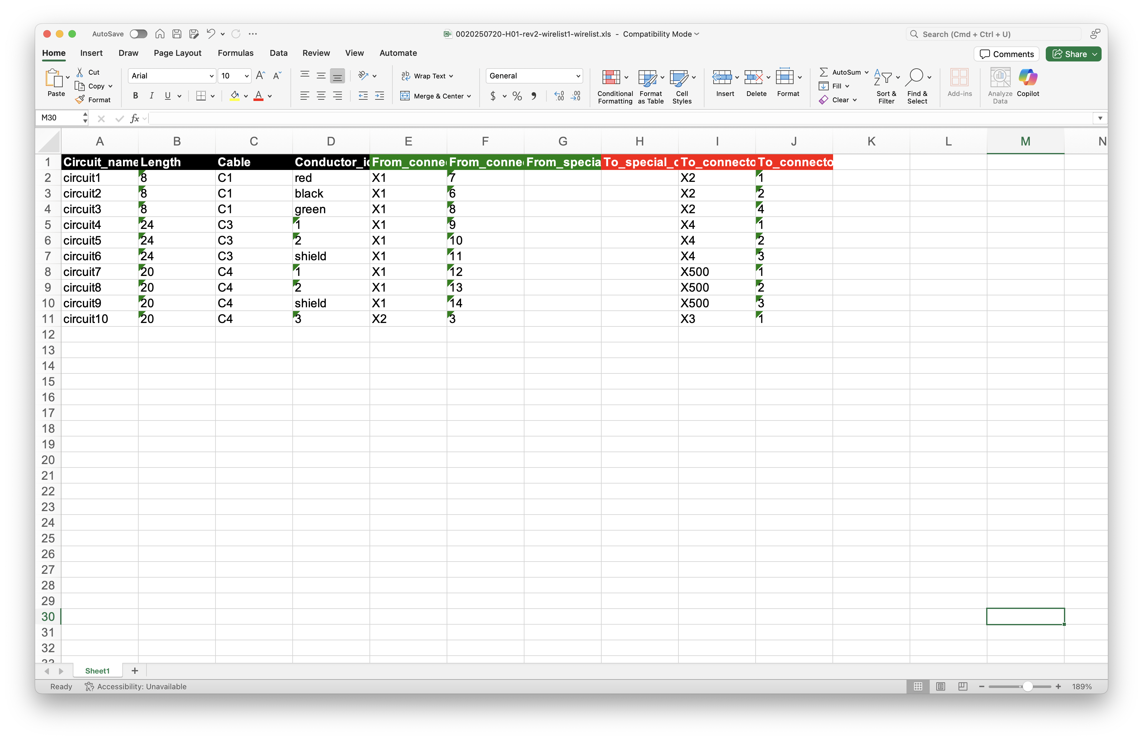
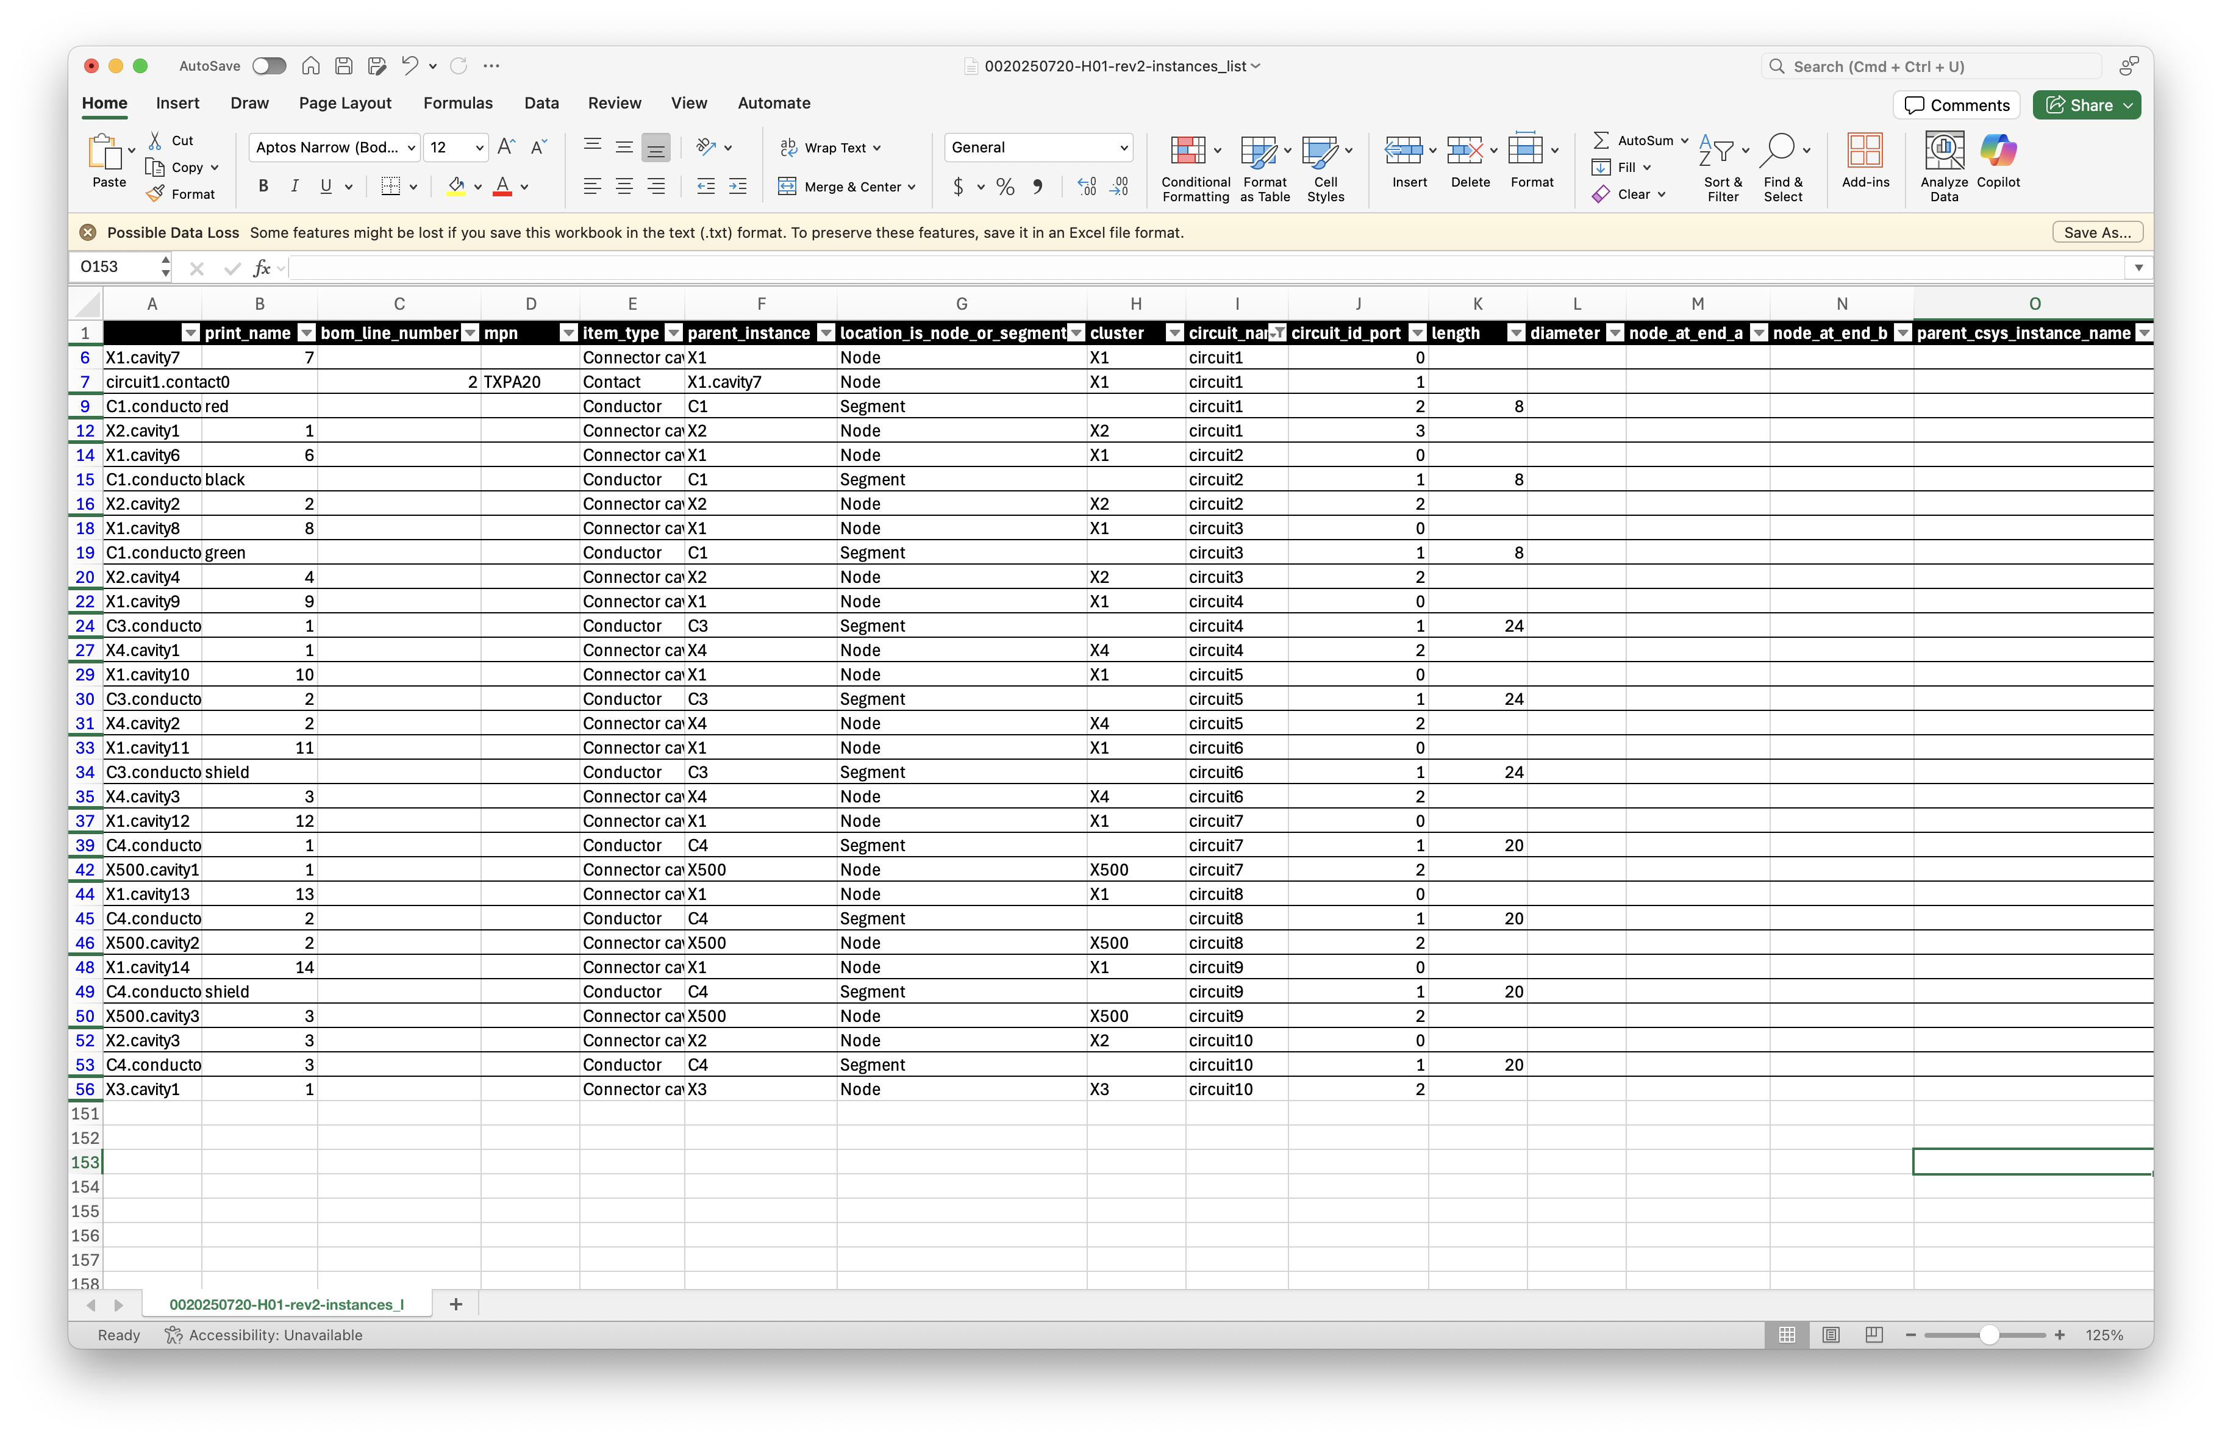
Of course…
All output artifacts are perfectly in sync with the Instances List

Slide 40
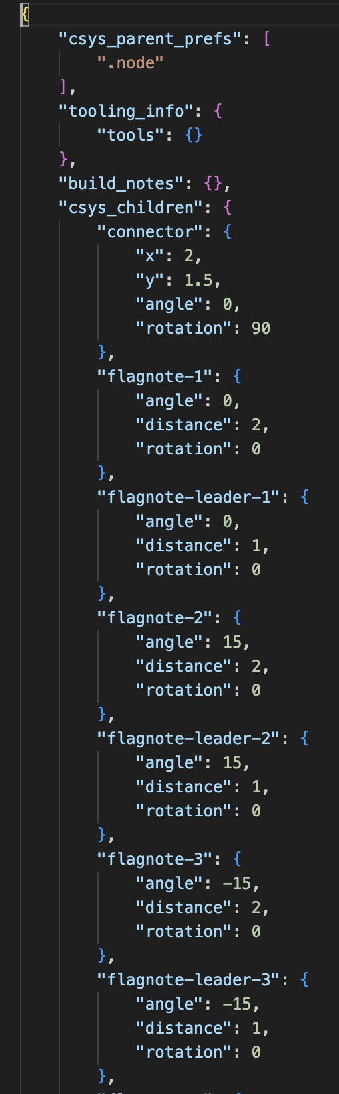
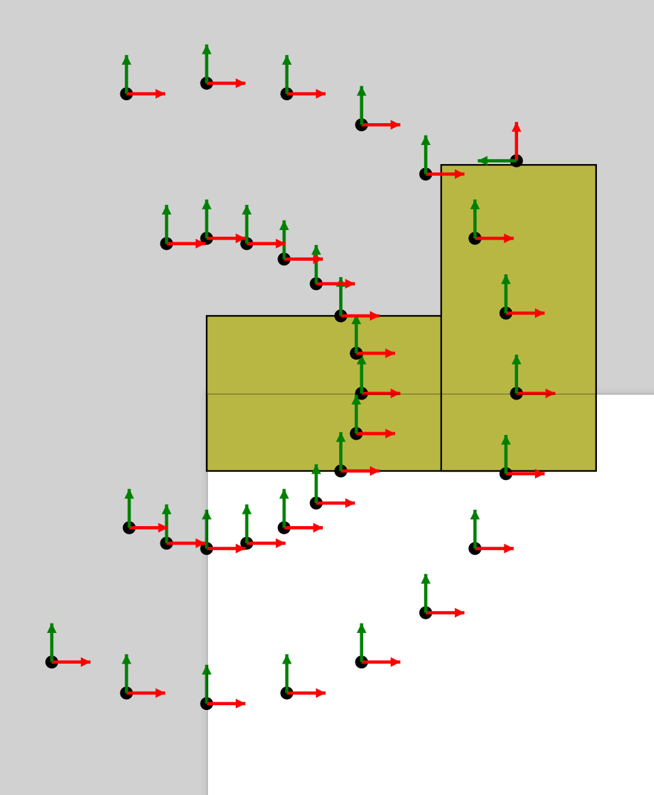
Every part can have as many child coordinate systems as you need
These can be referenced in the instances list
Used for things like flagnotes, child parts, or other related items
Can be used to place parts on a formboard drawing, calculate distances, etc

Slide 41
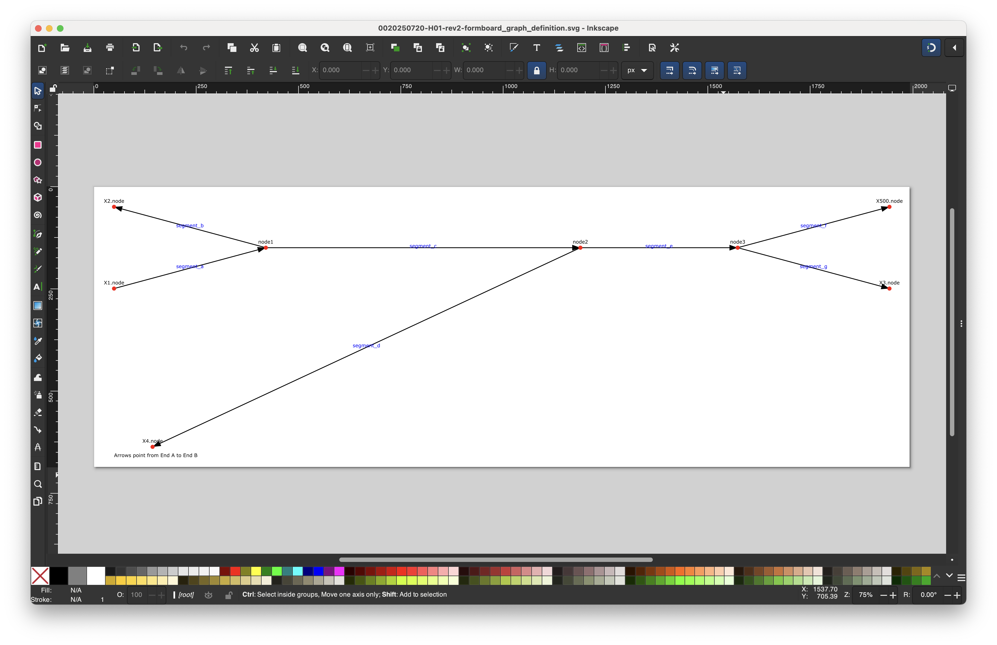
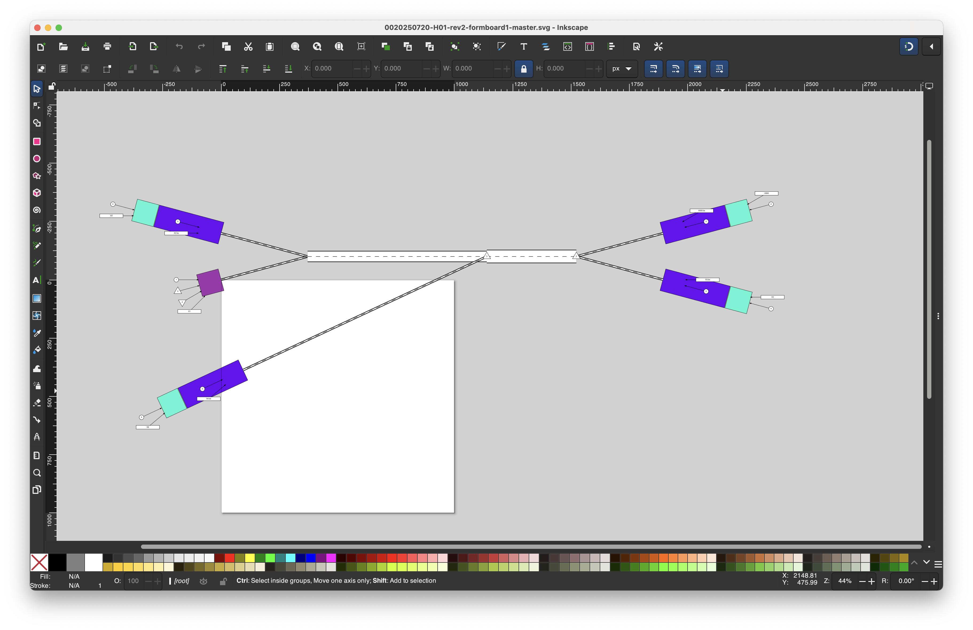
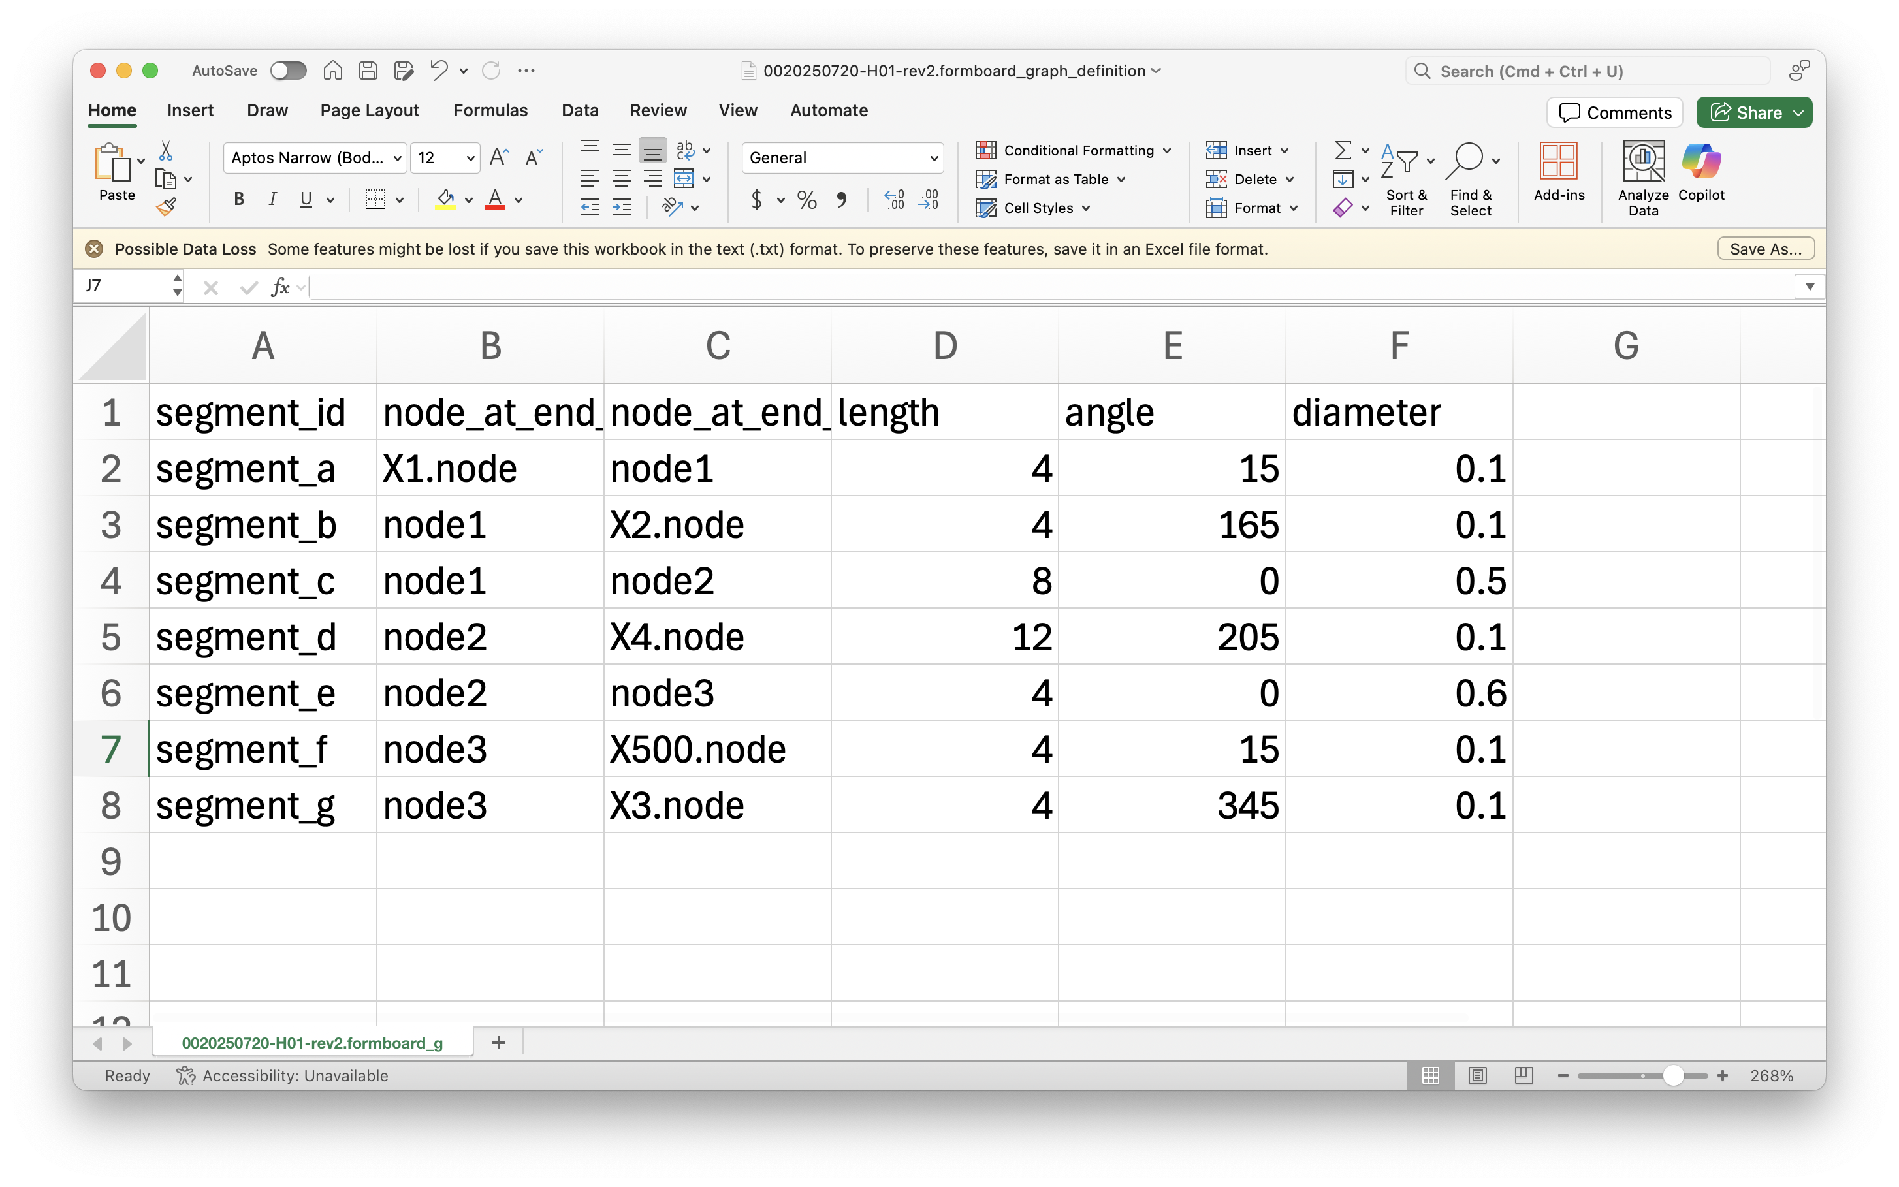
Defining a physical layout
For now, formboard_definition.tsv allows user to input length and angle preferences
These sync with cables and requirements from instances_list
Eventually, I’ll make a GUI

